Slide 1
Bootstrap Report Development

Slide 2
Introduction
Program to prepare online engineering report for the engineering team
The program will read the simple ASCII text files (prepared by Engineers) and convert into an online HTML report with following capabilities
Title page
D3JS interactive charts
Tables
Sections
Index

Slide 3
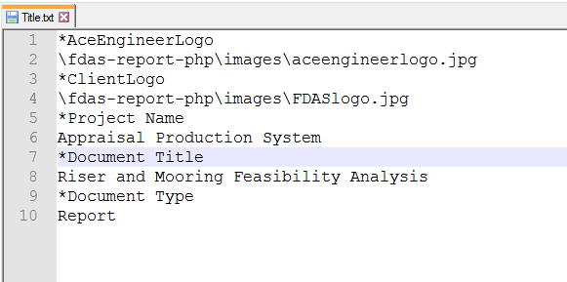
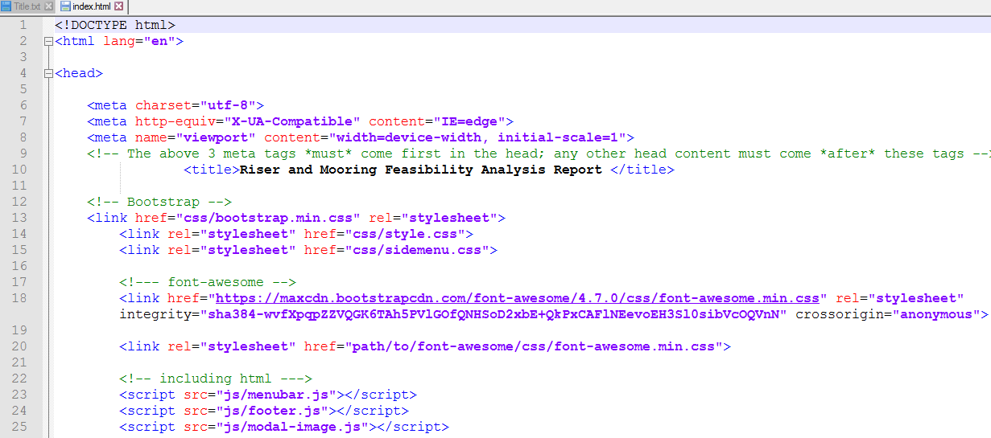
Basic Flowchart for Web Report
Prepare .csv files for charts and tables
(Engineer)
Improve this further.
Prepare .txt files
(Engineer)
Read .txt files and convert to .html files
(Program)
Deploy in Server (Engineer)

Slide 4

Flowchart for ???
Python Scripting Files
D3JS
Is this OrcaFlex specific? Please convert this.
Connect this to the high level dataflow above?
CSV
JavaScript
HTML
CSS
Bootstrap Web Report

Slide 5
Flowchart Process
Step 3:
CSV file stores tabular data (numbers and text) in plain text as excel format.it was obtained by d3js.
Csv files to td data format.
Step4:
To display the generated CSV file, linking the file into bootstrap, functioning terms like scrolling, hovering and for more effective representation in bootstrap web report.
HTML and CSS must be important with JavaScript.

Slide 6
Flowchart Process
Step 5
Bootstrap template is a free source from which we can develop the web report with our required format.
Bootstrap includes CSS, HTML and JavaScript.
CSV derives Data charts into the bootstrap report.

Slide 7
High Level Data Flow
Master File (Contains all data)
- General/project Data
Common data
ANSYS Data (based on common data and should be formula based)
Solidworks Data
For individual analysis
ANSYS, Solidworks, OrcaFlex, Blender, COMSOL etc.
Results for Web report
Web report

Slide 8
Flowchart Process
Step 1:
Python Script can interface directly to Orca flex and derive required chart values.
Step 2:
D3Js is JavaScript library for manipulate documents based on data using HTML, SVG and CSS. Report includes overview, examples, documentation, and source. Python chart values can be modulated by it.

